Slide 1
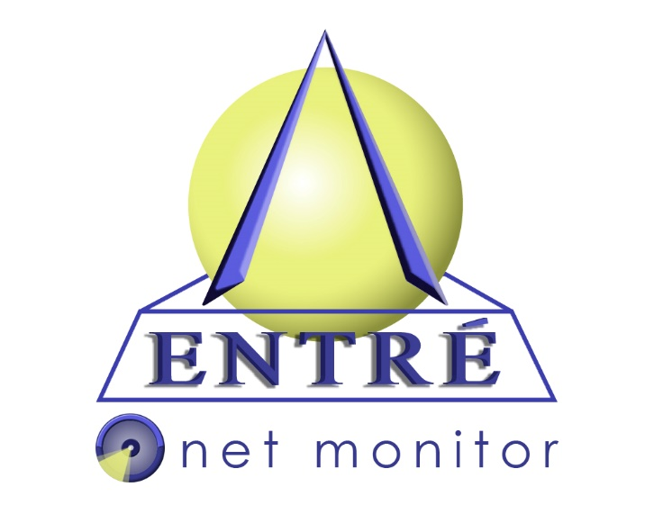
Entré NetMonitor
Proactive IT monitoring, Management and support
Think DIFFERENT about IT

Slide 2
Remote Monitoring - stay ahead when it comes to availability, performance and user experience problems
Manage and monitor vital information pertaining to Servers, SAN’s, Workstations and SNMP enabled devices
Dedicated Help Desk Technician monitors the performance and health of your network. Entré provides Bi-Annual Reviews of your networks health and helps to budget growth, performance and stability
Minimize downtime with real-time alerts

Slide 3
Remote Monitoring - stay ahead when it comes to availability, performance and user experience problems
Monitor the health of your server’s hardware including power supplies and hard drives by receiving alerts before they fail
Improve productivity by having the reporting tools needed to add additional resources based on monthly reporting
Analyze risks and threats with Hacker Check reporting
Monday through Friday, 8x5 monitoring with 24/7 alerting on critical hardware

Slide 4
Entre’s NetMonitor service allows us to be proactive in making our hardware and software decisions. Immediate alerts give us the information we need to promptly uncover an issue and implement an efficient and effective solution. Knowing that our server is being monitored around the clock gives us peace of mind and allows us to spend more time on our customers
Austin Larson, Rockford Map Publishers

Slide 5
Managed Workstations helps look after your PC’s health and updates
Take Control™ remote access—Entré can take control of your server and PC’s to solve the issues using our Help Desk Technician or Technical Engineer
Patch Management
Highlight potential risks
Enhance performance, reduce downtime
Help Desk—Monday-Friday (8AM-5PM) Support only a phone call away

Slide 6
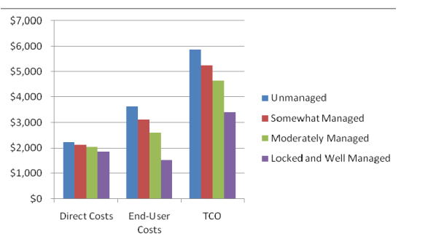
What does it really cost to own a PC?
Source: Gartner, 2008

Slide 7
Netmonitor has been extremely helpful to our network here at Cotta Transmission. I receive prompt notification of problems with the servers and pc’s on my network so I can address the issues quickly and get help from knowledgeable techs when I need it
Laura Boettcher, Cotta Transmission

Slide 8
Asset and Inventory Tracking - easy management and tracking of clients' software and hardware
Retrieve detailed hardware and software summaries of your network from one simple dashboard including Microsoft Windows Keys, Serial Numbers and hardware configurations
Rogue software on your network? Let Entré help monitor and manage software and hardware licensing you may not be aware of on the network

Slide 9
Did you know? Entré currently monitors 250+ servers and 900+ workstations in the Greater Rockford/Beloit Wisconsin area
Think DIFFERENT about IT

Slide 10
The most important factor for me is that I am assured that Entré knows what is going on with our network on a 24/7 basis, and addresses items before I am aware. This has saved our staff time dealing with IT issues, allowing us to better spend our time caring for our residents
Mark Ticknor, Wesley Willows Retirement Center

Slide 11
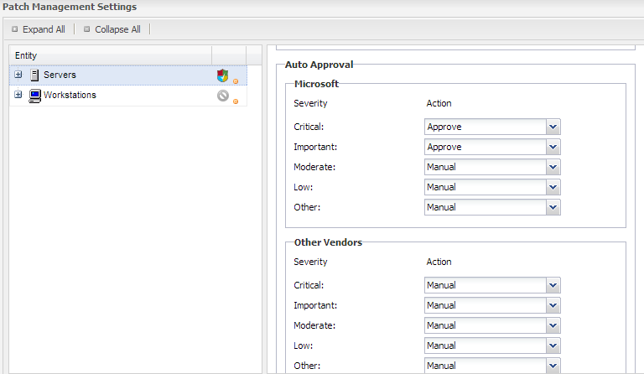
Patch Management – Who’s managing your updates?
Managed Security helps to protect your systems, minimize data theft and safeguard your business
Install patches and updates when you’re ready – while ensuring everyone is completely up to date and quickly identifying venerable areas on the network

Slide 12
Patch Management – who's managing your updates? Patch Tuesday Edition
In August 2007, Skype experienced a two-day outage following Patch Tuesday; according to Skype this was caused by a previously unidentified software bug exposed by an abnormally high number of restarts. Application of patches released on Patch Tuesday by a large number of users at the same time was identified as the cause of the high number of restarts

Slide 13
I like NetMonitor because sometimes it allows Entre to be aware of potential issues before it even affects us. It’s a very proactive approach to handling IT issues, really before they even become issues to the customer!
Michelle Gerke, Byron Forest Preserve

Slide 14
Think DIFFERENT about IT
Focus on your business, we will focus on its health! Let the data drive decisions and budgets

Slide 15
Managed Antivirus - Highly effective virus protection
Let Entré NetMonitor manage Quarantines, threats and updates for your Anti-Virus solution
Scalable, month by month fixed costs to AV, ensuring all users are protected

Slide 16
Think DIFFERENT about IT

Slide 17
Getting your network protected is easy. There is no hardware to install or any training required. Call Entré Computer Solutions to schedule a consultation for your company today Chris Soutar chriss@entrerock.com 815.399.5664 Entré NetMonitor Practice Manager

